Slide 1
Protractor \ E2E tests
E2e testing for angular Js

Slide 2
What is Protractor
Protractor is an end-to-end test framework for AngularJS applications. Protractor runs tests against your application running in a real browser, interacting with it as a user would.
Test Like a User
Protractor is built on top of WebDriverJS, which uses native events and browser-specific drivers to interact with your application as a user would.
For AngularJS Apps
Protractor supports Angular-specific locator strategies, which allows you to test Angular-specific elements without any setup effort on your part.
Automatic Waiting
You no longer need to add waits and sleeps to your test. Protractor can automatically execute the next step in your test the moment the webpage finishes pending tasks, so you don’t have to worry about waiting for your test and webpage to sync.

Slide 3
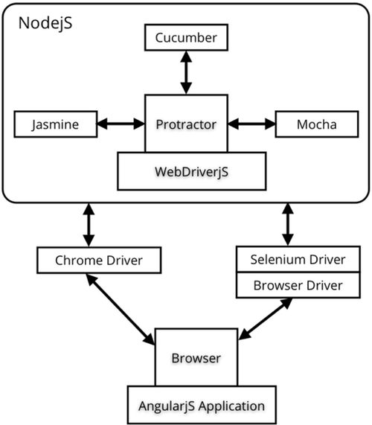
Protractor + BDD frameworks
BDD Frameworks
Protractor supports four behavior driven development (BDD) test frameworks: Jasmine 1.3, Jasmine 2.0, Mocha, and Cucumber. These frameworks are based on JavaScript and Node.js and provide the syntax, scaffolding, and reporting tools you will use to write and manage your tests.

Slide 4
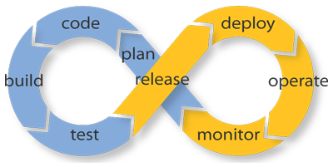
Protractor and Continous Integration
Support for many CI envirnoments
Protractor suport for Continous Integration envirnoment is strictly connected with BDD frameworks abilities.
Jasmine is a default BDD framework in protractor, it supports Jenkins, TeamCity, Hudson and many more CI envirnoments.
CI reporters can be easly attached to any test suite using Protractor config file

Slide 5
Getting started with Protractor
To get Protractor working:
Download Protractor using npm (npm install –g protractor@1.8.0)
Download the Chrome Driver & Selenium Server (already in repo)
Create the folder where tests & config file will be stored …
Prepare config file for protractor (basic config already in repo)
Write simple test (already in repo)
Run Protractor

Slide 6
Protractor config file
The minimal config should contains following sections:
exports.config = {} – as a configuration frame
seleniumServerJar or seleniumAddress pointing to the Selenium Server
chromeDriver pointing to the chromedriver (in case we are using Chrome)
suites or specs pointing to the path with tests
framework – if other than Jasmine 1.3

Slide 7
Protractor config file
Additional important sections:
capabilities section – defining browser details
baseUrl the default test URL
onPrepare function – here you can atttach reporter to the CI system
jasmineNodeOpts / cucumberOpts / mochaOpts – options of individual frameworks

Slide 8
Jasmine tests syntax
Following code represents basic Jasmine syntax :
describe ('My first test suite', function(){
it('Will do nothing', function(){
});
it('Will also do nothing', function(){
});
});

Slide 9
Jasmine assertions (matchers)
Basic schema of assertion: expect(A).matcher(B);
Following matchers are avaliable by default:
The 'toMatch' matcher is for regular expressions
The 'toBeDefined' matcher compares against `undefined`
The `toBeUndefined` matcher compares against `undefined`
The 'toBeNull' matcher compares against null
The 'toBeTruthy' matcher is for boolean casting testing
The 'toBeFalsy' matcher is for boolean casting testing
The 'toContain' matcher is for finding an item in an Array
The 'toBeLessThan' matcher is for mathematical comparisons
The 'toBeGreaterThan' matcher is for mathematical comparisons
The 'toBeCloseTo' matcher is for precision math comparison
The 'toThrow' matcher is for testing if a function throws an exception
The 'toThrowError' matcher is for testing a specific thrown exception
All matchers can be negated by adding .not before matcher
User can define own matchers in the tests code

Slide 10
Web elements locators
Protractor supports it’s own implementation of web elements locators, which is fully compilant with webdrivers implementation and extended by Angular-specific locators:
Locators in protractor are defined as follows:
element/all (by.locator(<locator string>))
Avaliable locators:
- css
- id
xpath
tagName
Binding (ng-binding)
Repeater (ng-repeat)
model (ng-model)
Name
exactBinding
buttonText

Slide 11
Locators tricks & tips, good practices for using locators, examples
Locators can be combined:
element(by.id(<someId>)). element(by.css(<someCss>)).
element(by.tagName(<someTag>)).
all(by.repeater(<someRepeater>))
etc.

Slide 12
Locators tricks & tips, good practices for using locators, examples
CSS Locators can be used as other basic locators :
element(by.css(„.class”)) = css locator
element(by.css(„button”)) = tag locator
element(by.css(„#ideee”)) = id locator

Slide 13
Locators tricks & tips, good practices for using locators, examples
CSS Locators can be combined:
element(by.css(„.class button #id”))

Slide 14
Locators tricks & tips, good practices for using locators, examples
CSS Locators can be used for advanced search:
element(by.css(`buton[class*=„foo”]`)) -> find buton with class name containing „foo” string
element(by.css(`.someCss:not(.ng-hide)`)) -> find only visible elements with css = .someCss
element(by.css(`a:contains(„Change password”)`)) -> find only links elements with text= „Change password”

Slide 15
Locators tricks & tips, good practices for using locators, examples
CSS Locators can be used for horizontal search:
element(by.css(`.ng-binding.ng-show.dimmed`)) -> find element with given 3 classes at the same level

Slide 16
Actions on objects
Protractor supports a range of default actions on located web elements:
click()
sendKeys()
getAttribute()
isPresent()
isDisplayed()
clear()
getText()
- Many many more:(protractor API)
!!! All of above actions return promisses and need to be solved by using then function

Slide 17
Writing tests in Protractor(exercise 1)
Write your first test using sample structure given in repo
Pre-requirements:
- Protractor correctly installed
- We are using yesterday’s application
Node server started on localhost:8080 (hosting our web app)
(lesson-6-path/node server.js)
Test must be runned from the Lesson 6 folder directly using CMD
Requirements:
- Locate input box of tested application
Give a unique name of your new ToDo task
Add the task
Check if the task is displayed on the list (by name)

Slide 18
Writing tests in Protractor(exercise 2)
Write your first test using sample structure given in repo
Pre-requirements:
- Protractor correctly installed
- We are using yesterday’s application
Node server started on localhost:8080 (hosting our web app)
(lesson-6-path/node server.js)
Test must be runned from the Lesson 6 folder directly using CMD
Requirements:
- Locate input box of tested application
Give a unique name of your new ToDo task
Add the task
Check if the task is displayed on the list (by name)
Click on added element
Check if is marked as done
Verify if All and ToDo counters have correct values

Slide 19
E2E tools tribute – page objects
Let’s analyse the code of our POP library and see how the informations from previous part of course can be used in real live
Layer 1:
POP library
Layer 2:
Defining page objects
Layer 3:
Writing tests

Slide 20
HTTP backend mocks 4 Protractor
HttpBackend workflow is quite simple:
On browser.get() a mock module is injected to your angularjs application
On when*or when you call manually backend.sync(), fixtures is synchronised with your angularjs app.

Slide 21
HTTP backend mocks 4 Protractor
var HttpBackend = require('httpbackend');
var backend = null;
describe('Test Http backend methods', function() {
beforeEach(function() {
backend = new HttpBackend(browser);
});
afterEach(function() {
backend.clear();
});
it('Test whenGET with string response', function() {
backend.whenGET(/result/).respond('raoul');
browser.get('http://127.0.0.1:8080');
var result = element(by.binding('result'));
expect(result.getText()).toEqual('raoul');
});
});

Slide 22
Thank You
Dziękuje za uwagę

